Slide 1
MATRIMONIAL SYSTEM matches are made in Heaven WE are just a medium
SECOND REVIEW
2_-12-2012
Presented By
Gaurav Ingalkar
Karun Bhardwaj
Ravi Sharma

Slide 2






How System Works ?
Fill Personal Information
Fill The Partner Criteria
Get Perfect Matches
User Registration
select one and Confirm marriage
Choose Services

Slide 3

Project development phases :
FIRST PHASE (Initial):
2) SECOND PHASE(Current):

Slide 4
Initial phase:
First ER Design - Problems :
Data was not consistent
Unwanted tables
Problems in finding estimation of marriage
Hall estimation was not included
Problems in organizing Events

Slide 5
Suggestions
Rollup function for Estimation Of Cost
Using Views
Use Joins
Use of Date and time functions – Add date(),curdate(),year(),Month()
Union
If null
Procedures
Triggers
Order by
Group by
Sub Queries
Concat

Slide 6
Second Phase:
Earlier Problems:
Data was not consistent
Unwanted tables
Problems in finding estimation of marriage
Hall estimation was not included
Problems in organizing Events
New ER design
Implemented concept of membership
Account Open Date and Expiry Date Concept Added
Find match Functionality added
Cost Estimation Of Marriage

Slide 7
Whats New ??
Services What we are Providing
Membership Planning
Estimation Of marriage
Event Organization
Estimation Of Events
Caterers and food supply
Beautician
And Most Important…….. Free Advices

Slide 8
Second Phase: Technical Relevance
Reports :
Match_finder Query
Problems with Match_finder Query
Updated Match Finder (Procedure)
Why Procedure?
Membership Planning Query
problems ?
Use of trigger ?

Slide 9

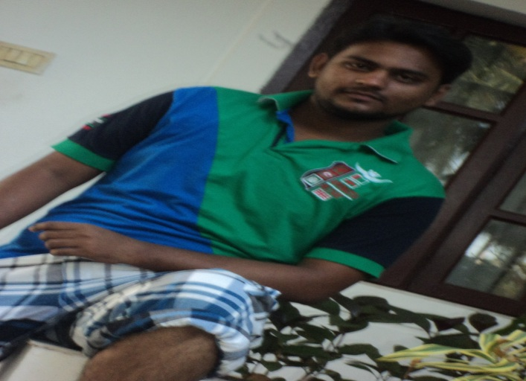
Find Match For Aishwarya Rai
CALL match_finder(2,‘Groom');

Slide 10


Second Phase: Technical Relevance
CALL match_finder(7,'bride');

Slide 11

Find Match For user_id 5
CALL match_finder(5,‘bride');

Slide 12




Second Phase: Technical Relevance
CALL match_finder(1,'bride');

Slide 13
DELIMITER &&
CREATE TRIGGER set_passwordAndDate before insert ON personal_details FOR EACH ROW
BEGIN
DECLARE name varchar(100);
UPDATE register
set register.user_password = (select password('name')),
start_date =curdate(),
Acc_Expiry_Date = adddate(curdate(),interval 1 month)
where register.user_id = new.user_id;
END &&
DELIMITER;

Slide 14
Estimation OF marriage cost:
Event wise cost Estimation and list of services
Use of roll up function for Final Cost Estimation

Slide 15
Procedure to find services in a event
DELIMITER
$$
CREATE PROCEDURE find_services_in(event varchar(25),guest_count integer)
BEGIN
SELECT s.service_name AS "SERVICE NAME",if(s.service_name='Food',s.charges*guest_count,s.charges) AS "CHARGES"
FROM service_list s
JOIN event_booking e ON (e.service_code=s.service_code)
JOIN event_master em ON(em.event_id=e.event_id)
WHERE em.event_name=event;
END $$

Slide 16

*Services provided in Dinner and their charges CALL find_services_in('Dinner',500);

Slide 17

#Services in Engagement & their charges CALL find_services_in('Engagement Ceremony',200);

Slide 18
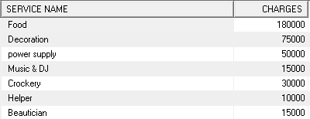
#Services in reception & their charges CALL find_services_in('Reception',300);

Slide 19
*Procedure to find Total charges of a particular event delimiter $$ CREATE PROCEDURE find_charges_for(event varchar(25),guest_count integer ) BEGIN SELECT em.event_name as "EVENT NAME",ifnull(sum(if(s.service_name='Food',s.charges*guest_count,s.charges)),0) AS "CHARGES" FROM service_list s JOIN event_booking e on (e.service_code=s.service_code) JOINevent_master em on(em.event_id=e.event_id) WHERE em.event_name=event; END $$

Slide 20

* CALL find_charges_for('Engagement Ceremony',200);

Slide 21

* CALL find_charges_for('Sangeet Party',null);

Slide 22
# Services being used in different events SELECT em.event_name AS "EVENT NAME",GROUP_CONCAT(s.service_name) AS "SERVICES USED" FROM event_master em JOIN event_booking e ON(e.event_id=em.event_id) JOIN service_list s ON (e.service_code=s.service_code) JOIN master_wed w ON (w.wedding_id=e.wedding_id) GROUP BY(event_name);

Slide 23
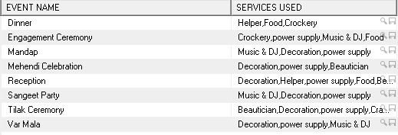

Slide 24

Query to find event having maximum charges
SELECT EVENT_NAME,charges AS "CHARGES" FROM events_cost WHERE charges= (SELECT MAX(charges) FROM events_cost);

Slide 25
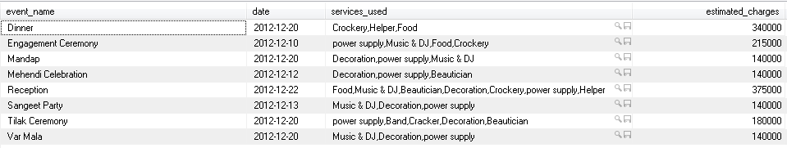
Find event date,Charges and services to be used in particular events
SELECT em.event_name ,e.Event_Date AS "date",GROUP_CONCAT(s.service_name) AS "services_used",ec.charges AS "estimated_charges"
FROM event_booking e
JOIN event_master em ON (e.event_id=em.event_id)
JOIN service_list s ON (s.service_code=e.service_code)
JOIN events_cost ec ON (ec.event_name=em.event_name)
JOIN master_wed m ON (m.wedding_id=e.wedding_id)
GROUP BY (event_name);

Slide 26
Find Hall Charges For a Wedding
CREATE VIEW Hall_charge
AS
SELECT w.wedding_id AS WeddingId,h.hall_name AS Name,h.charges AS Charges
FROM halls h
JOIN wedding_info w ON(h.hall_id=w.hall_id)
JOIN master_wed m ON(m.wedding_id=w.wedding_id);

Slide 27
View to get the Estimated cost of All Events
CREATE VIEW event_cost
AS
SELECT
ifnull(event_name,'Estimated Cost') as "EventNAME",SUM(
CASE
when event_name='Engagement Ceremony' then event_cost('Engagement Ceremony',200)
when event_name='Mehendi Celebration' then event_cost('Mehendi Celebration',null)
when event_name='Sangeet Party' then event_cost('Sangeet Party',null)
when event_name='Mandap' then event_cost('Mandap',null)
when event_name='Tilak Ceremony' then event_cost('Tilak Ceremony',null)
when event_name='dinner' then event_cost('dinner',500)
when event_name='Var Mala' then event_cost('Var Mala',null)
when event_name='Vidaai Ceremony' then event_cost('Vidaai Ceremony',null)
when event_name='Reception' then event_cost('Reception',300)
END) as "CHARGES"
FROM event_master
GROUP BY (event_name) WITH ROLLUP;

Slide 28
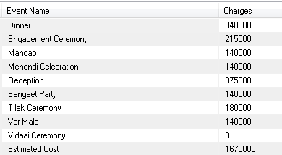
Estimated Cost Of All Events
SELECT EventName as "Event Name",Charges FROM event_cost;

Slide 29

Total Estimated Cost Of A Wedding
SELECT h.weddingid as "Wedding Id",h.charges+e.charges as "Total Estimated Cost" FROM event_cost e
JOIN hall_charge h WHERE eventName='Estimated Cost';

Slide 30
Future Scope:
Creating Multiuser Environment
Membership Renewal system
Moto to make user convenience all in one system
Honey moon travel plan ..

Slide 31

Thank You

